Slide 1
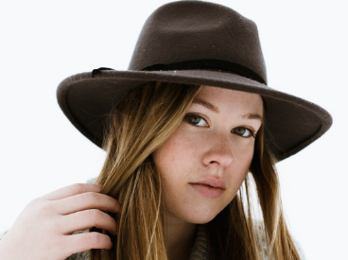
What Strong Women Do . . . via Krysten Ritter
Strong Women Meditate
Strong Women Stay Present
Strong Women Laugh at Their Fears
Strong Women Find the Good in Bad Experiences
Strong Women Embrace Being Unique
Strong Women Don’t Apologize
Strong Women Pay It Forward
MyIncredibleWebsite.com

